Slide 1
Launching a GloboDiet version

Slide 2
Instructions to start a project
When starting a project, an agreement among the countries/institutes participating in a project has to be found in terms of
Food and recipe classifications – rules on handling of complex foods such as soups, snacks
Level of details for the description
Quantification methods
Setting files (list of food consumption occasions, of places of consumption, of special days, of special diets…)
To come up with the common files of the project.

Slide 3
Common classifications (1)
Food groups (# sub-(sub-)groups)
Unclassified (0)
Potato and other tubers (2)
Vegetables (9)
Legumes (2)
Fruits, nuts and seeds (4)
Dairy products and substitutes (19)
Cereals and products (9)
Meat, meat products and substitutes (20)
Fish, shellfish and amphibians (5)
Eggs and egg products (2)
Cakes and sweet biscuits (3)
Fats and oils (5)
Sugar and confectionary (4)
Non-alcohol beverages (10)
Alcoholic beverages (7)
Condiments, spices, sauces and yeast (9)
Soups and bouillons (3)
Miscellaneous (6)
Salty snacks (3)

Slide 4
Common classifications (2)
Usually, analyses are not run at that level but at the food/ingredient level only so IARC leaves more room to customisation.
Recipe groups (# sub-groups)
Based on meat and meat products (6)
Based on fish and crustaceans/molluscs (3)
Based on egg (0)
Based on cereal and cereal products (6)
Based on vegetables (incl. potatoes) (5)
Mixed beverages (0)
Soups (6)
Sweet recipes (5)
Sauces (0)
Other (0)
→ Define what will be in the food and recipe lists

Slide 5
Show files in Microsoft word
..\..\3_COMMON\LIBRARY e-SMP\FDCLASS.doc
..\..\3_COMMON\LIBRARY e-SMP\RCPCLASS.txt

Slide 6
Description (1)
Two complementary food description systems are used in GloboDiet: explicit and implicit.
Implicit description:
The name of a food provides sufficient information to identify the food (e.g. “gherkins”, “prune”, “lactose-free milk”).
Explicit description:
Facets/questions and descriptors/answers are used during the process of food
identification.
Rules on what detail to include in the name must be decided for each project.
For example, if fortification in the country is not common but some multivitamin juices exist, it is better to have fortification in the name of the food rather than having a (systematic) facet to check for it.

Slide 7
Description (2)
In GloboDiet, foods, recipes and dietary supplements are described using a series of facets (e.g. preservation method, cooking method) and descriptors (e.g. fresh, raw) which are defined according to the level of precision that
the subjects are able to provide
the project needs to analyse the consumption data
Facets and descriptors are available in the IARC library (Thesaurus). Some may be added to it.
The description rules are defined by (sub-sub-)groups.
Define the facets and descriptors
Prepare the food and recipe lists

Slide 8
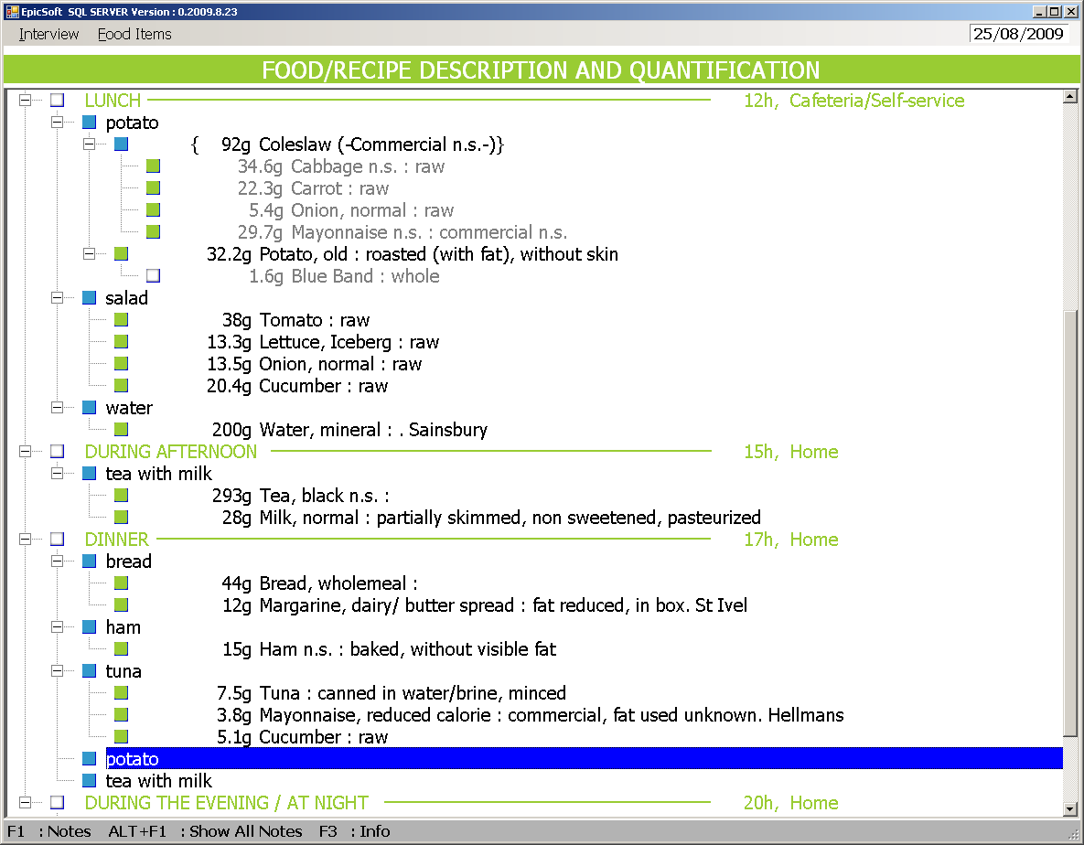
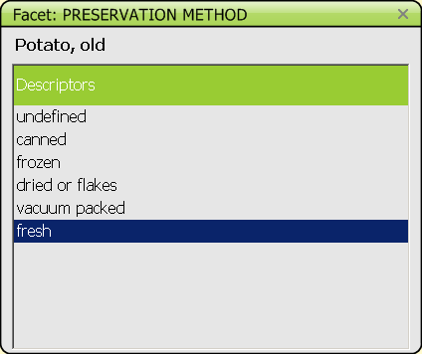
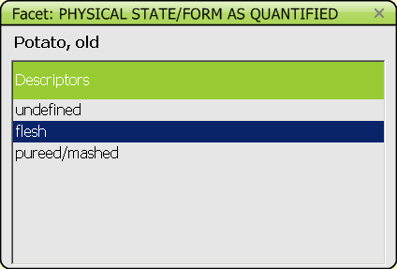
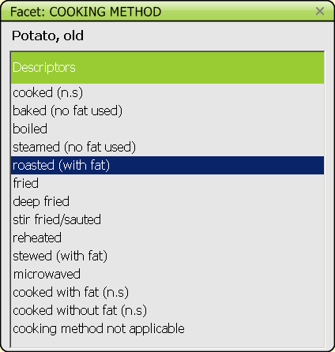
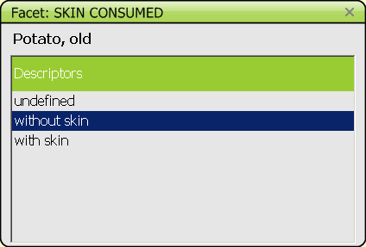
Description (3)

Slide 9
Initial instructions for the description files
Define the list of facets needed for the project (“FADECODE” and “RCPFADECODE”).
  Refer to Thesaurus for definitions and complete library of available facets.
  In addition, example of food lists is provided as a reference to give an idea of how much detail will be in the name of the food (implicit description) versus that what will further described through facet/descriptors (explicit description).
Define the list of related descriptors (“FADECODE” and “RCPFADECODE”). Refer to Thesaurus for definitions and complete library of available descriptors.
When an agreement has been found, translate the facets and descriptors into your local language(s).

Slide 10
Description of foods (1)
The database FADECODE is divided into
FACETS.xls: list of facets.
NB: The European consortium of GloboDiet users works to harmonise the description and quantification across countries.
* mandatory for the quantification
Source
Physical state as quantified*
Cooking method*
Preservation method
Packing medium
Flavoured/added components
Sugar content/sweetening agent
Fat content
Packaging
Food preparation/production
Enriched/fortified
Brand name/product name (open list)
Skin consumed
Visible fat consumed
Type of fat used (open list)
Type of milk/liquid used (open list)
Geographic origin
Salt/sodium content
Extent of cooking…

Slide 11
Description of foods (2)
2. DESCFACE.xls : list of descriptors
Example for facet 07 SUGAR CONTENT/SWEETENING AGENT
    00 undefined
    01 non sweetened
    02 sweetened with sugar
    03 sweetened with artificial sweetener
    04 sugar reduced
    06 light n.s.
    07 sweetened n.s.
    09 sweetened with fructose…
    90 not registered in diary
→ Gather food brands

Slide 12
Description of recipes
R_FACET.xls: list of facets
Recipe production*
    Known/unknown*
    Brand name/product name (open list)
    Preservation method
    Type of packaging
    Reheating method
* mandatory for the recipe pathway
R_DESCFACE.xls: list of descriptors
→ Gather recipe brands

Slide 13
Show files in Microsoft word
..\..\Demo\z_end\BelNet\fadecode.txt
..\..\Demo\z_end\BelNet\rcpfadecode.txt

Slide 14
Quantification
Using the picture book
  Household measures
  Shapes for bread, cake…
  Photos of portions
Standard units
Volume
Weight

Slide 15
Quantification by photos (1)
IARC proposes photos from
The GloboDiet picture book, 1995
PANCAKE project – DTU 2010-11
MenuCH project, 2012
INCA3 project – DTU 2012-13
Swiss MenuCH project
For
foods/dishes
shapes
household measures

Slide 16
Quantification by photos (2)
You need to check that the needed photos can be found in the IARC photo library, else prepare new photos according to the IARC guidelines.
→ Suit local needs

Slide 17
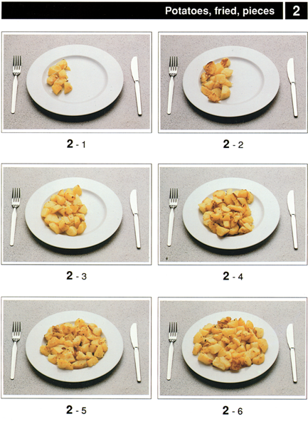
1- Foods/dishes

Slide 18

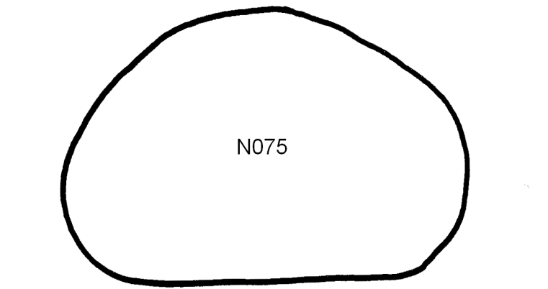
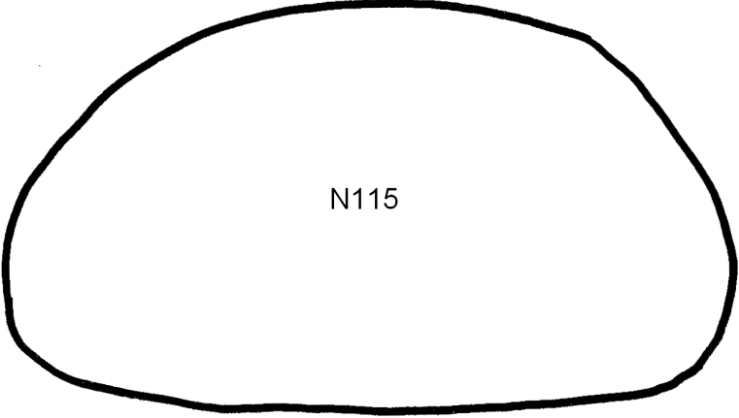
2- Shapes
N= normal, R=rectangular, S=square, F=flat, W=weird
Surface in cm2
Related thicknesses in cm

Slide 19
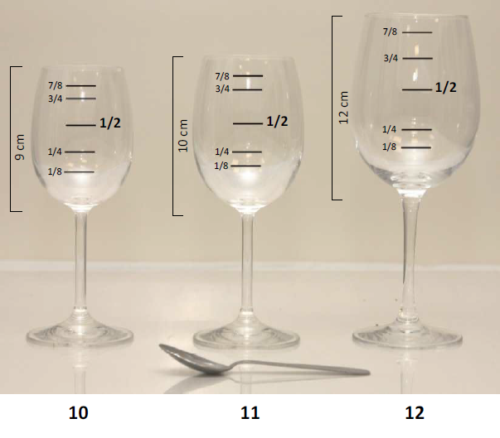

3- Household measures
Shapes
Volumes
Dimensions
Fractions
Spoons
Mugs
Cups
Bowls…
→ Specific training on picture book

Slide 20
Related to quantification
Need to gather information on
Standard units
Examples:
    medium tomato (D47-67mm) = 105g, raw, with inedible part
    small concentrated tomato paste can (1/12 size -D50 H35) =70g, cooked, without inedible part
→ Gather information (standard weight/volume, dimensions, is the weight/volume as raw or cooked?, with or without inedible part?) on commercial products and fresh products that can be quantified by units
Standard portions
Examples:
    melted/grated cheese on pasta
    nuts on ice cream
Densities in g/cm2
Raw-to-cooked coefficients
Edible part coefficients

Slide 21
Recipes
Gather information on recipes from cook books, internet…
..\..\1_Guidelines-UserManual\GloboDiet\Subject Specific\Description\Format_recipe_information.xlsx
A specific course on the Recipe manager will be given when the Food GloboDiet version is ready

